Slide 1

TRAVEL BOOKING AGENCY WEBSITE
PROJECT
Batch – 2
241FA04194: Durga
241FA04319: Madhavi
241FA04283: Uday
241FA04558: Trinadh
SUBMITTED TO:
Kumar Devapogu sir
Department of CSE
Field Project

Slide 2
Contents:
Introduction
Problem statement
Existing system
Hardware & Software Requirements
Advantages
Disadvantages
Sample Code
Result
Conclusion
Department of CSE
Field Project

Slide 3
Introduction:
The Travel Booking Agency Website project is designed to provide an online platform for travelers to explore destinations, view travel services, and plan their trips easily. This website helps users access travel information, book services, and contact the agency from anywhere. The project focuses on creating a user-friendly, attractive, and responsive website using web technologies such as HTML and CSS.
Department of CSE
Field Project

Slide 4
Problem Definition
The Travel Agency Website project aims to solve these problems by providing a centralized, user-friendly online platform where customers can explore destinations, view available travel services, and contact the agency easily. This website helps automate information sharing, improves customer engagement, and enhances accessibility, making travel planning faster, simpler, and more efficient.
Department of CSE
Field Project

Slide 5
Existing System:
Travel agencies rely on manual processes and traditional methods.
Customers must visit the agency in person or contact via phone.
Information is provided through brochures or verbal communication.
Limited availability of updated destination and package details.
Time-consuming process for inquiries and bookings.
Manual record-keeping increases chances of errors.
Limited customer reach (mostly local).
No 24/7 access to travel information.
Department of CSE
Field Project

Slide 6
Hardware & Software Requirements
Hardware Requirements
Computer or Laptop
Processor: Intel Core i3 or higher
RAM: Minimum 4 GB
Hard Disk: Minimum 250 GB
Internet Connection
Software Requirements
Operating System: Windows 10 / Windows 11
Web Browser: Google Chrome, Mozilla Firefox, or Microsoft Edge
Front-End Technologies: HTML, CSS
Code Editor: Visual Studio Code / Notepad++
Department of CSE
Field Project

Slide 7
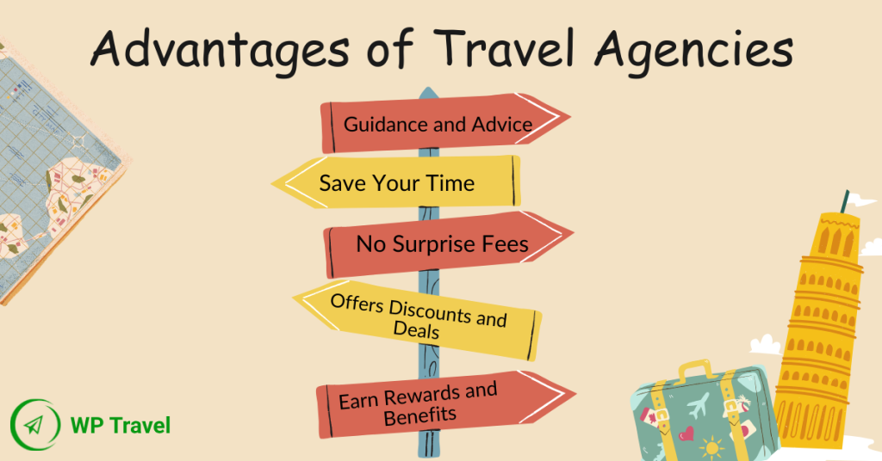
Advantages:
Convenience & Speed: Users can search and book flights, hotels, and experiences anytime without waiting for office hours or standing in queues.
Price Comparison & Savings: Aggregator sites allow travelers to compare prices across multiple providers to find the best deals, often with lower rates than booking directly.
Instant Confirmation & Flexibility: Bookings are confirmed instantly, and digital tickets/vouchers are stored in one place, reducing paperwork.
Enhanced Information & Reviews: Access to user-generated reviews and ratings helps travelers make informed, data-driven decisions.
24/7 Access: The ability to manage or book travel on the go via mobile apps provides flexibility for last-minute changes or bookings.
Loyalty & Rewards: Many platforms offer loyalty programs, allowing users to earn points, discounts, or perks for future travel.
Department of CSE
Field Project

Slide 8

Disadvantages:
Complex Customer Service & Changes: If a problem arises, resolving issues, cancellations, or booking changes through an OTA can be difficult, often involving long waits or unresponsive support.
Hidden Fees and Higher Prices: Despite claims of the best deals,, these platforms may include hidden charges, and it is possible to find lower prices by booking directly with airlines or hotels.
Rigid Cancellation Policies: Unlike direct booking, OTA policies can be inflexible, making it hard to adjust or cancel plans.
Lack of Loyalty Benefits: Hotels often consider third-party bookings ineligible for loyalty points, upgrades, or special benefits, reducing the value for frequent travelers.
Reduced Personalization: The experience is impersonal, lacking the expert advice or customized service a travel agent can provide.
Risk of Overbooking: There is a higher risk of booking errors or overbooking during peak seasons.
Department of CSE
Field Project

Slide 9
Sample code:
<!DOCTYPE html>
<html lang="en">
<head>
<meta charset="UTF-8">
<meta name="viewport" content="width=device-width, initial-scale=1.0">
<title>Travel Booking Agency Website</title>
<style>
*{
margin:0;
padding:0;
box-sizing:border-box;
font-family:Arial, Helvetica, sans-serif;
}
body{
line-height:1.6;
color:#333;
}
header{
background:url('https://images.unsplash.com/photo-1507525428034-b723cf961d3e') no-repeat center center/cover;
height:90vh;
color:white;
}
nav{
display:flex;
justify-content:space-between;
align-items:center;
padding:20px 60px;
background:rgba(0,0,0,0.5);
}
Department of CSE
Field Project

Slide 10
nav h1{
font-size:28px;
}
nav ul{
list-style:none;
display:flex;
}
nav ul li{
margin-left:20px;
}
nav ul li a{
color:white;
text-decoration:none;
font-weight:bold;
}
nav ul li a:hover
{
color:#ff9800;
}
.hero{
height:80%;
display:flex;
align-items:center;
justify-content:center;
text-align:center;
}
.hero h2{
font-size:48px;
margin-bottom:15px;
}
.hero p{
font-size:20px;
margin-bottom:25px;
}
Department of CSE
Field Project

Slide 11
.btn{
padding:12px 25px;
background:#ff9800;
color:white;
text-decoration:none;
border-radius:5px;
border:none;
cursor:pointer;
}
section{
padding:60px;
}
.section-title{
text-align:center;
margin-bottom:40px;
}
/* DESTINATIONS */
.destinations,
.services{
display:grid;
grid-template-columns:repeat(auto-fit,minmax(250px,1fr));
gap:25px;
max-width:1000px;
margin:auto;
}
.card{
border-radius:10px;
overflow:hidden;
box-shadow:0 4px 10px rgba(0,0,0,0.1);
background:white;
}
.card img{
width:100%;
height:180px;
}
Department of CSE
Field Project

Slide 12
.card-content{
padding:20px;
}
.about{
background:#f4f4f4;
text-align:center;
}
.contact form{
max-width:500px;
margin:auto;
display:flex;
flex-direction:column;
}
.contact input,
.contact textarea{
padding:12px;
margin-bottom:15px;
border:1px solid #ccc;
border-radius:5px;
}
footer{
background:#222;
color:white;
text-align:center;
padding:20px;
}
@media(max-width:768px){
nav{
flex-direction:column;
}
}
</style>
Department of CSE
Field Project

Slide 13
</head>
<body>
<header>
<nav>
<h1>Travel Booking Agency Website </h1>
<ul>
<li><a href="#destinations">Destinations</a></li>
<li><a href="#services">Services</a></li>
<li><a href="#about">About</a></li>
<li><a href="#contact">Contact</a></li>
</ul>
</nav>
<div class="hero">
<div>
<h2>Explore the World With Us</h2>
<p>Your dream vacation starts here</p>
<a href="#contact" class="btn">Book Now</a>
</div>
</div>
</header>
<section id="destinations">
<h2 class="section-title">Popular Destinations</h2>
<div class="destinations">
<div class="card">
<img src="https://images.unsplash.com/photo-1502602898657-3e91760cbb34" alt="">
<div class="card-content">
<h3>Paris</h3>
<p>The city of love and lights.</p>
</div>
</div>
Department of CSE
Field Project

Slide 14
<div class="card">
<img src="https://images.unsplash.com/photo-1505761671935-60b3a7427bad" alt="">
<div class="card-content">
<h3>Maldives</h3>
<p>Crystal clear waters and luxury resorts.</p>
</div>
</div>
<div class="card">
<img src="https://images.unsplash.com/photo-1500530855697-b586d89ba3ee" alt="">
<div class="card-content">
<h3>New York</h3>
<p>The city that never sleeps.</p>
</div>
</div>
</div>
</section>
<section id="services">
<h2 class="section-title">Our Services</h2>
<div class="services">
<div class="card">
<div class="card-content">
<h3>Flight Booking</h3>
<p>Best deals on domestic and international flights.</p>
</div>
</div>
Department of CSE
Field Project

Slide 15
<div class="card">
<div class="card-content">
<h3>Hotel Reservations</h3>
<p>Comfortable stays at affordable prices.</p>
</div>
</div>
<div class="card">
<div class="card-content">
<h3>Tour Packages</h3>
<p>Customized tours tailored to your needs.</p>
</div>
</div>
</div>
</section>
<section id="about" class="about">
<h2 class="section-title">About Us</h2>
<p>
Travel booking agency website is a trusted travel agency helping travelers explore the world
with unforgettable experiences. We specialize in personalized travel plans,
ensuring comfort, safety, and joy.
</p>
</section>
<section id="contact" class="contact">
<h2 class="section-title">Contact Us</h2>
Department of CSE
Field Project

Slide 16
<form>
<input type="text" placeholder="Your Name" required>
<input type="email" placeholder="Your Email" required>
<textarea rows="5" placeholder="Your Message"></textarea>
<button class="btn" type="submit">Send Message</button>
</form>
</section>
<footer>
<p>© 2026 TRAVEL BOOKING AGENCY WEBSITE. All Rights Reserved.</p>
</footer>
</body>
</html>
Department of CSE
Field Project

Slide 17
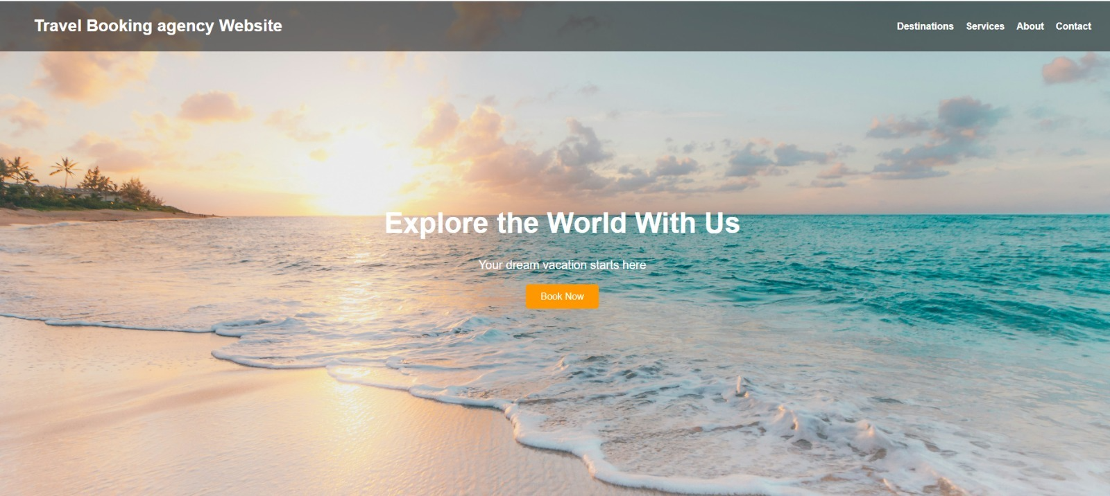
Result:
Department of CSE
Field Project

Slide 18

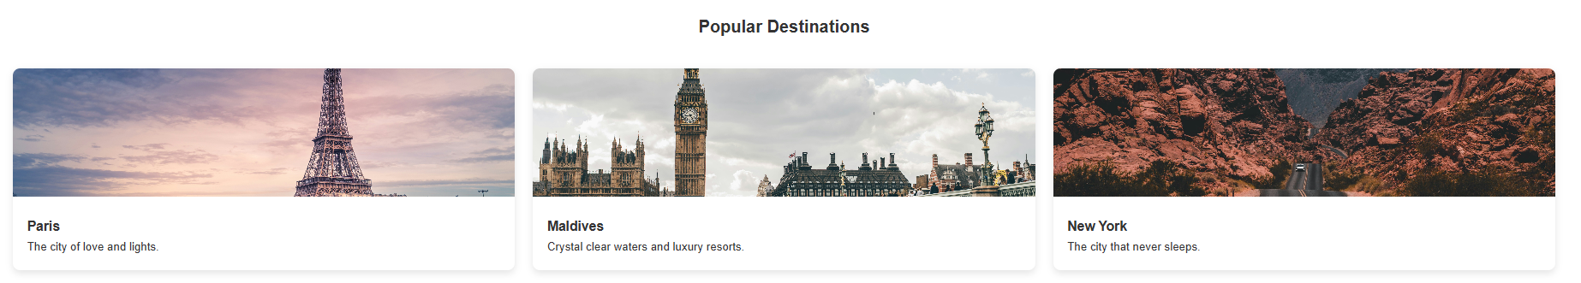
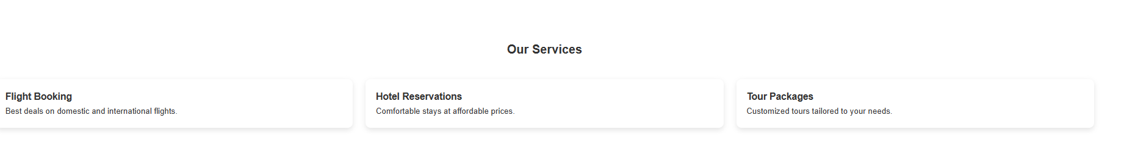
Department of CSE
Field Project

Slide 19
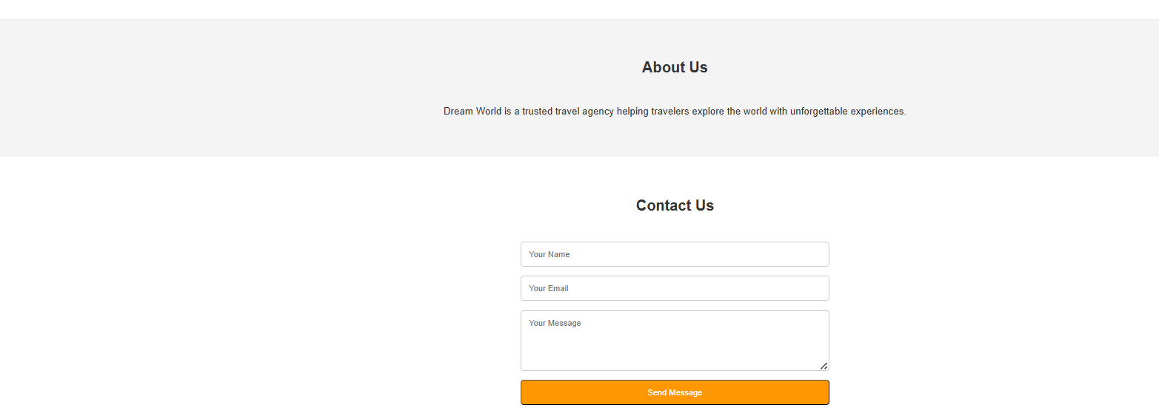
Department of CSE
Field Project

Slide 20
Conclusion:
The Travel Booking Agency Website simplifies travel planning.
It provides a modern, efficient, and user-friendly platform.
The project demonstrates effective use of HTML and CSS.
This project reduces manual effort, saves time for both customers and staff, and improves accessibility by providing information 24/7. By moving from a traditional offline system to a web-based approach, the travel agency can reach a wider audience and improve customer satisfaction.
Overall, this project highlights the importance of digital solutions in the travel industry and shows how basic web technologies can be effectively applied to solve real-world problems.
Department of CSE
Field Project

Slide 21


Department of CSE
Field Project

